Slide 1


Multi-Agent Music Concert Recommender System (MCRS)
In this presentation we are presenting:
An Overview for MCRS .. (Recall).
MCRS Key Functionalities.
Implementation approach.
MCRS Agents syncing with running their code.
SENG696|Team1|December 11, 2023

Slide 2
Team Members
Khawla Naji Shnaikat
Jagrit Acharya
Raheel Afsharmazayejan
Raha Moradi Shahmiri

Slide 3
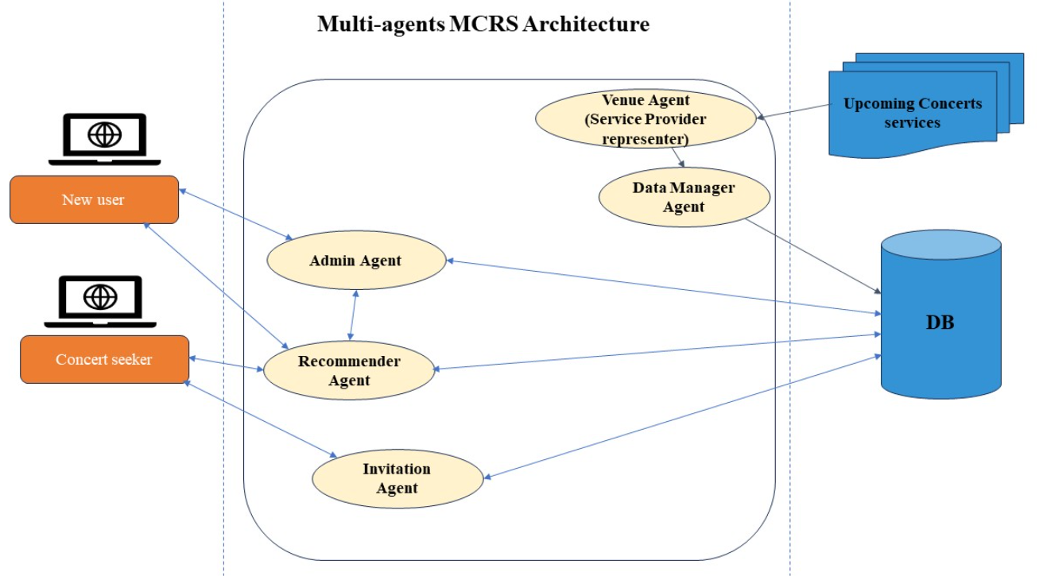
Overview … Recall MCRS Architecture

Slide 4
Key Functionalities for MCRS
Profile creation for new users.
Users' verification.
Concerts recommendation.
Potential friends finding.

Slide 5
Implementation Approach
A clear role for each agent.
Agents Interaction.
Various Implementing techniques when:
Inserting data: using arguments and GUIs.
Debugging and handling errors: via GUI messages or through the console.
Showing results: GUI and Console.
Maintaining up-to-date DB.

Slide 6
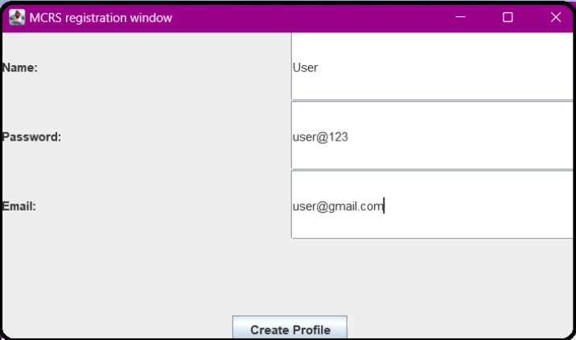
MCRS Agents:
1. Admin Agent
Has a GUI.
Manage user-related operations.
Profile creation: user registration and insertion the user personal info into users table,
Data validation to address any errors in the provided data fields.
Users verification: if a registered user is new or existing within the system.

Slide 7
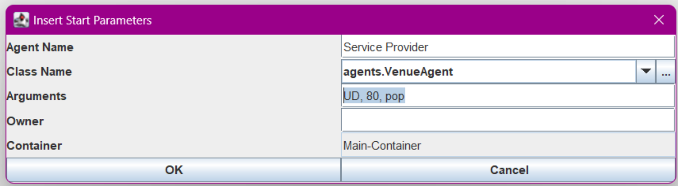
2. Venue Agent
This agent acts as a service provider
Receives arguments which represent Concert's information: location, ticket price, and genre.
Provides error handling when inserting wrong number of arguments.

Slide 8
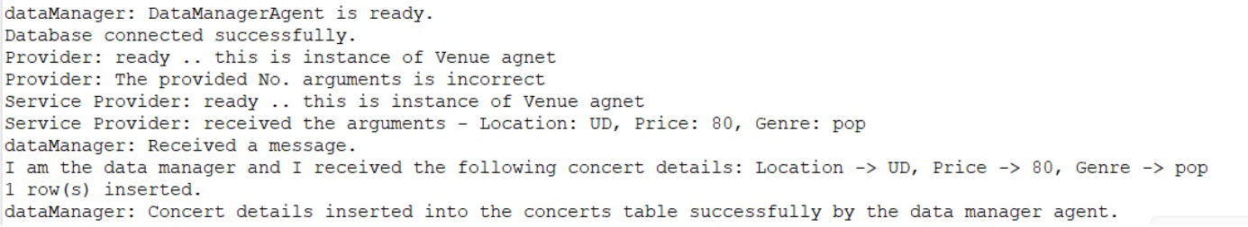
3. Data Manager Agent
Receives concert's information from the Venue agent (provider).
Updates mcrs-db, particularly, concerts table.

Slide 9
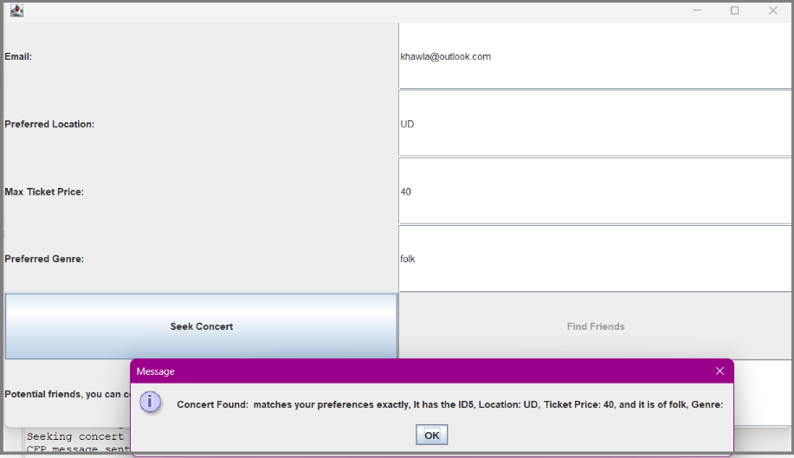
4. Concert Seeker Agent (User GUI Representation)
Has a GUI.
Allow the concert seeker to provide: Email, concert preferences: location, ticket price. and genre.
Sending concert seeking request according to the inserted preferences.
Will enable the "Find friends" button, if a concert recommendation was received.

Slide 10
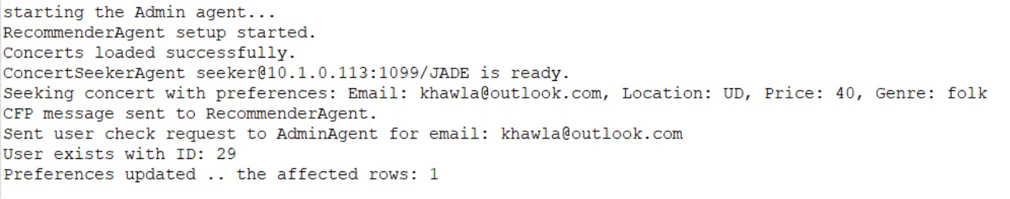
5. Recommender Agent
Load concerts information from DB.
Receives concert seeker input, including email, location preference, ticket price, and genre.
User verification by communicating with the Admin Agent:
If the seeker's email does not exist, prompts the to create a profile
Else, proceed with seek concert service.
Inserts the user's preferences into the preferences table.
Finds a concert that matches seeker's preferences.
Or, respond with no upcoming matching concerts.

Slide 11
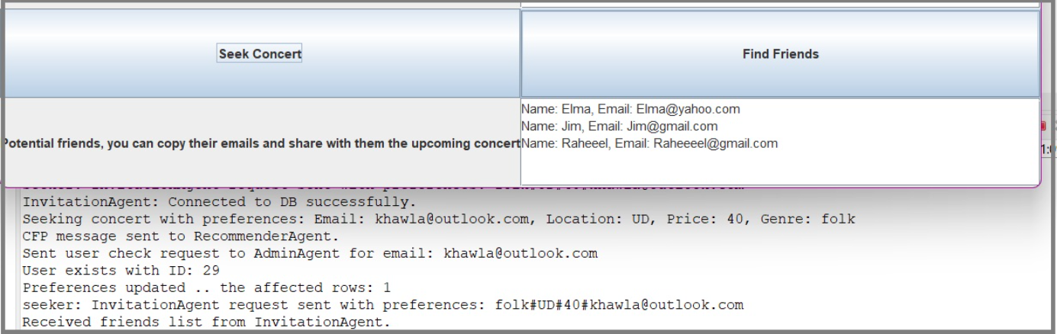
6. Invitation Agent
Once a concert recommendation is received, a "Find Friends" button becomes available.
Clicking this button transmits the Concert Seeker's preferences to the Invitation Agent.
The Invitation Agent then identifies potential friends with similar preferences and then updating the friends table accordingly.

Slide 12
Thank you
Questions and discussions

